Slide 1


TOP MOBILE PHONE ANALYSIS
COMP-8547 Advanced Computing Concepts
Instructor: Dr. Olena Syrotkine

Slide 2

Team Name : Status 200
TEAM MEMBERS
Chandini Priya Kondru - 110094181
Valiant Dmello - 110089739
Naiket Patel - 110089315
Darshil Patel - 110091604
Krupal Rudani - 110092052
Status 200

Slide 3
AGENDA
• Introduction
• Features Implemented
• Concepts used
• Software Used
• Project’s Workflow
• Demo
• References
Status 200

Slide 4
INTRODUCTION
THE PROJECT USES A MOBILE SELLER WEBSITE TO CRAWL THROUGH WEB AND USE DIFFERENT ALGORITHMS AND DATA STRUCTURES TO GIVE WEB PAGE SUGGESTION AS PER INPUT KEYWORDS
Status 200

Slide 5

FEATURES IMPLEMENTED
Web Crawler
Data Validation Using Regex
HTML Parser
Inverted Indexing and Frequency Count
Page Ranking
Spell Checking
Word Completion
Search Frequency
Status 200

Slide 6

WEB CRAWLER
It will fetch the content of the website and provides the child webpages which are embedded in the given website.
We Use a HashSet to store all the links
Status 200

Slide 7
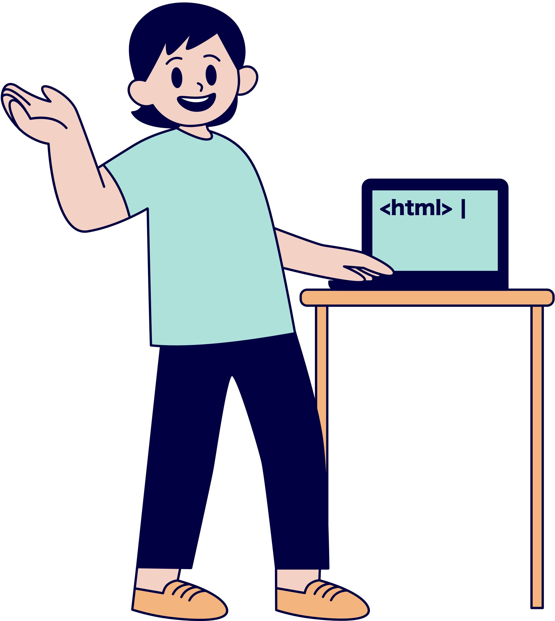
HTML PARSER
It extracts the data of webpage into a simple text format or say it is used to fetch the content of the webpage by extracting specific tags
It is stored in text files
Status 200

Slide 8
INVERTED INDEXING
It stores the keywords as keys and the count of words as values and also the number of textfiles containing the words by using hash maps.
Using Hass Table to store the word as key and the frequencies as value
FREQUENCY COUNT
It is generally the no. of occurences of the words in documents , counting them and storing.
Status 200

Slide 9
PAGE RANKING
It checks for the occurrence of the given url in the webpage and rank them as per the number of occurrence.
We Use a Maximum heap to store all the pages' score.
Status 200

Slide 10
IT IS USED TO CHECK THE GIVEN INPUT BY THE USER AND USING ALGORITHMS LIKE EDIT DISTANCE, PROVIDE THE CORRECT SPELLING TO THE USER.
SPELL CHECKING
Status 200

Slide 11
WORD COMPLETION
It is used to complete the whole word provided
by the user.
We use a Trie DS to store all the words.
Status 200

Slide 12

SEARCH FREQUENCY
It is used to count the frequency of the word searched by the user.
Status 200

Slide 13
Concepts Used
Edit Distance
Ranking and Sorting
Jsoup
Hash Table
Trie
Status 200

Slide 14

SOFTWARE
Eclipse IDE
Status 200

Slide 15
Team Contribution
NAIKET
DARSHIL
Inverted Indexing - InvertedIndexing.java
Frequency Count
Web Crawler - WebCrawler.java
HTML Parser - HTMLParser.java
VALIANT
Word Completion - WordCompletion.java
Code Integration - Main.java
CHANDINI
KRUPAL
Spell Checking - SpellChecking.java
Search Frequency - Search.java
Data Validation using regular Expression
Page Ranking - PageRanking.java
Status 200

Slide 16
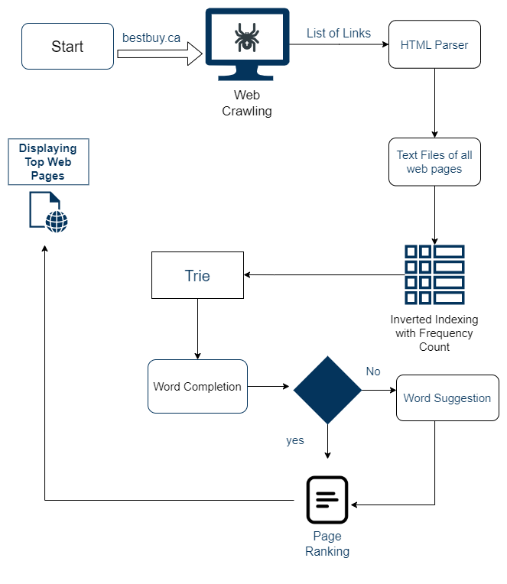
PROJECT WORKFLOW
Status 200

Slide 17
Demo
Status 200

Slide 18
REFERENCES
https://www.youtube.com/watch?v=giiaIofn31A&ab_channel=MichaelMuinos
https://www.youtube.com/watch?v=wrFXBV4MwvI&ab_channel=CodingWithTim
https://www.geeksforgeeks.org/edit-distance-dp-5/

Slide 19
Thank you
Status 200

